Slide 1



Room 2 Power BI
View in Power BI
Last data refresh:
1/24/2023 8:11:27 AM UTC
Downloaded at:
1/24/2023 8:17:42 AM UTC

Slide 2
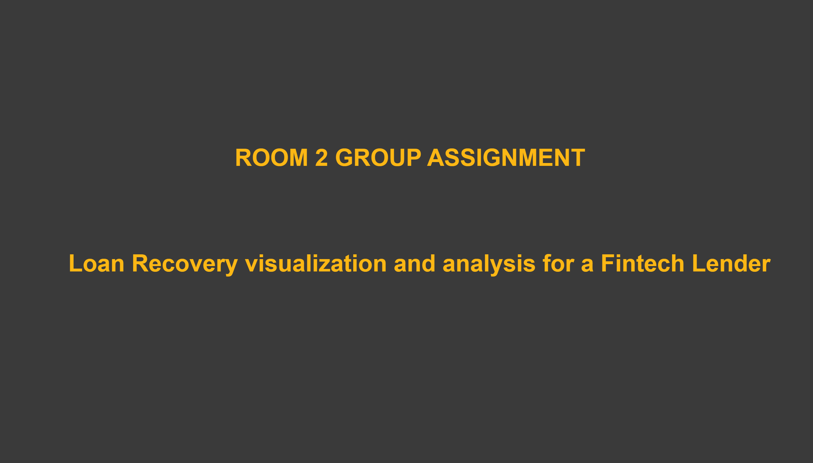
Cover Page
Notes:
textbox
No alt text provided
textbox
No alt text provided

Slide 3
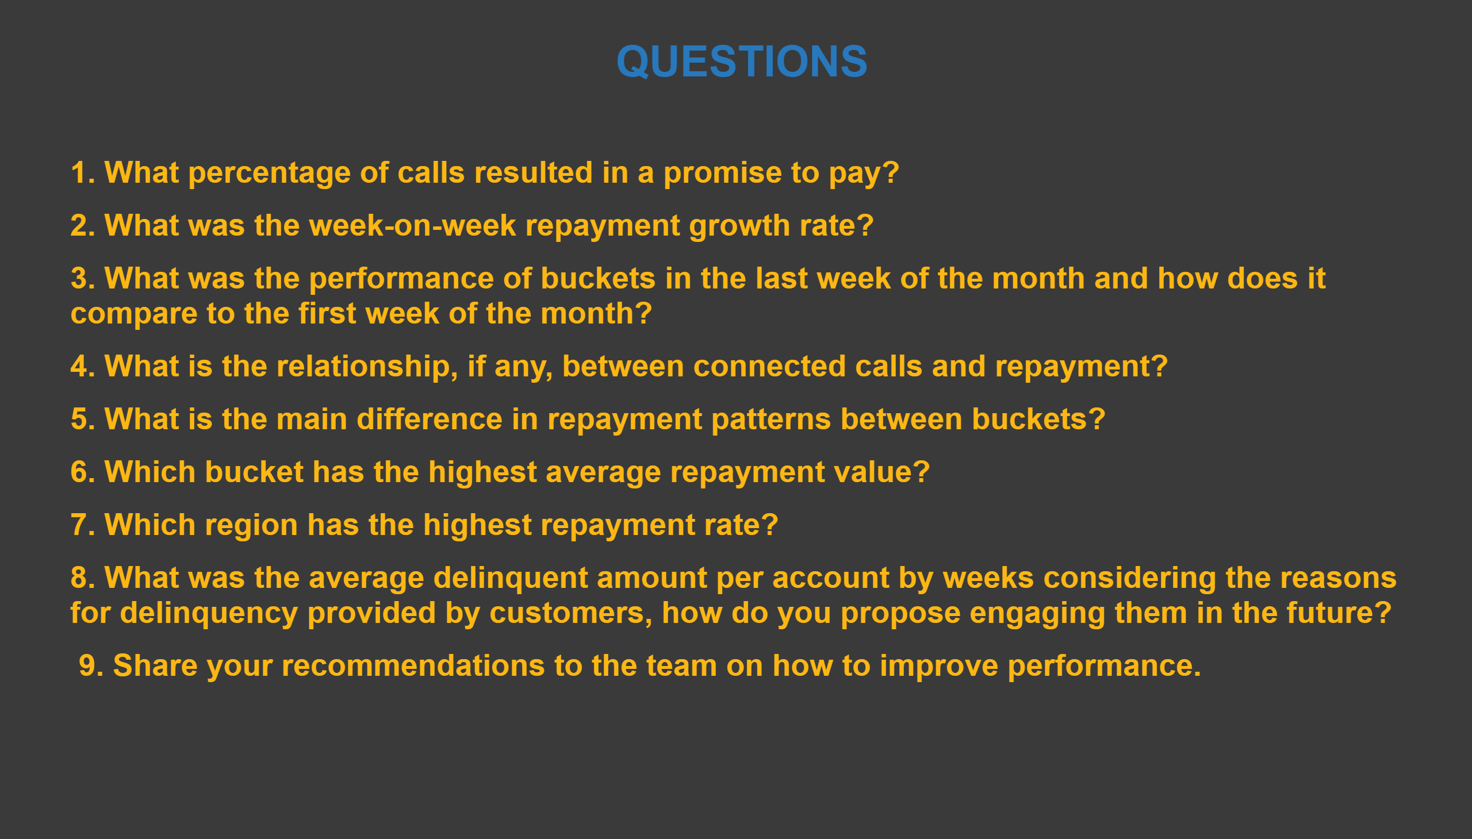
Questions
Notes:
textbox
No alt text provided
textbox
No alt text provided

Slide 4
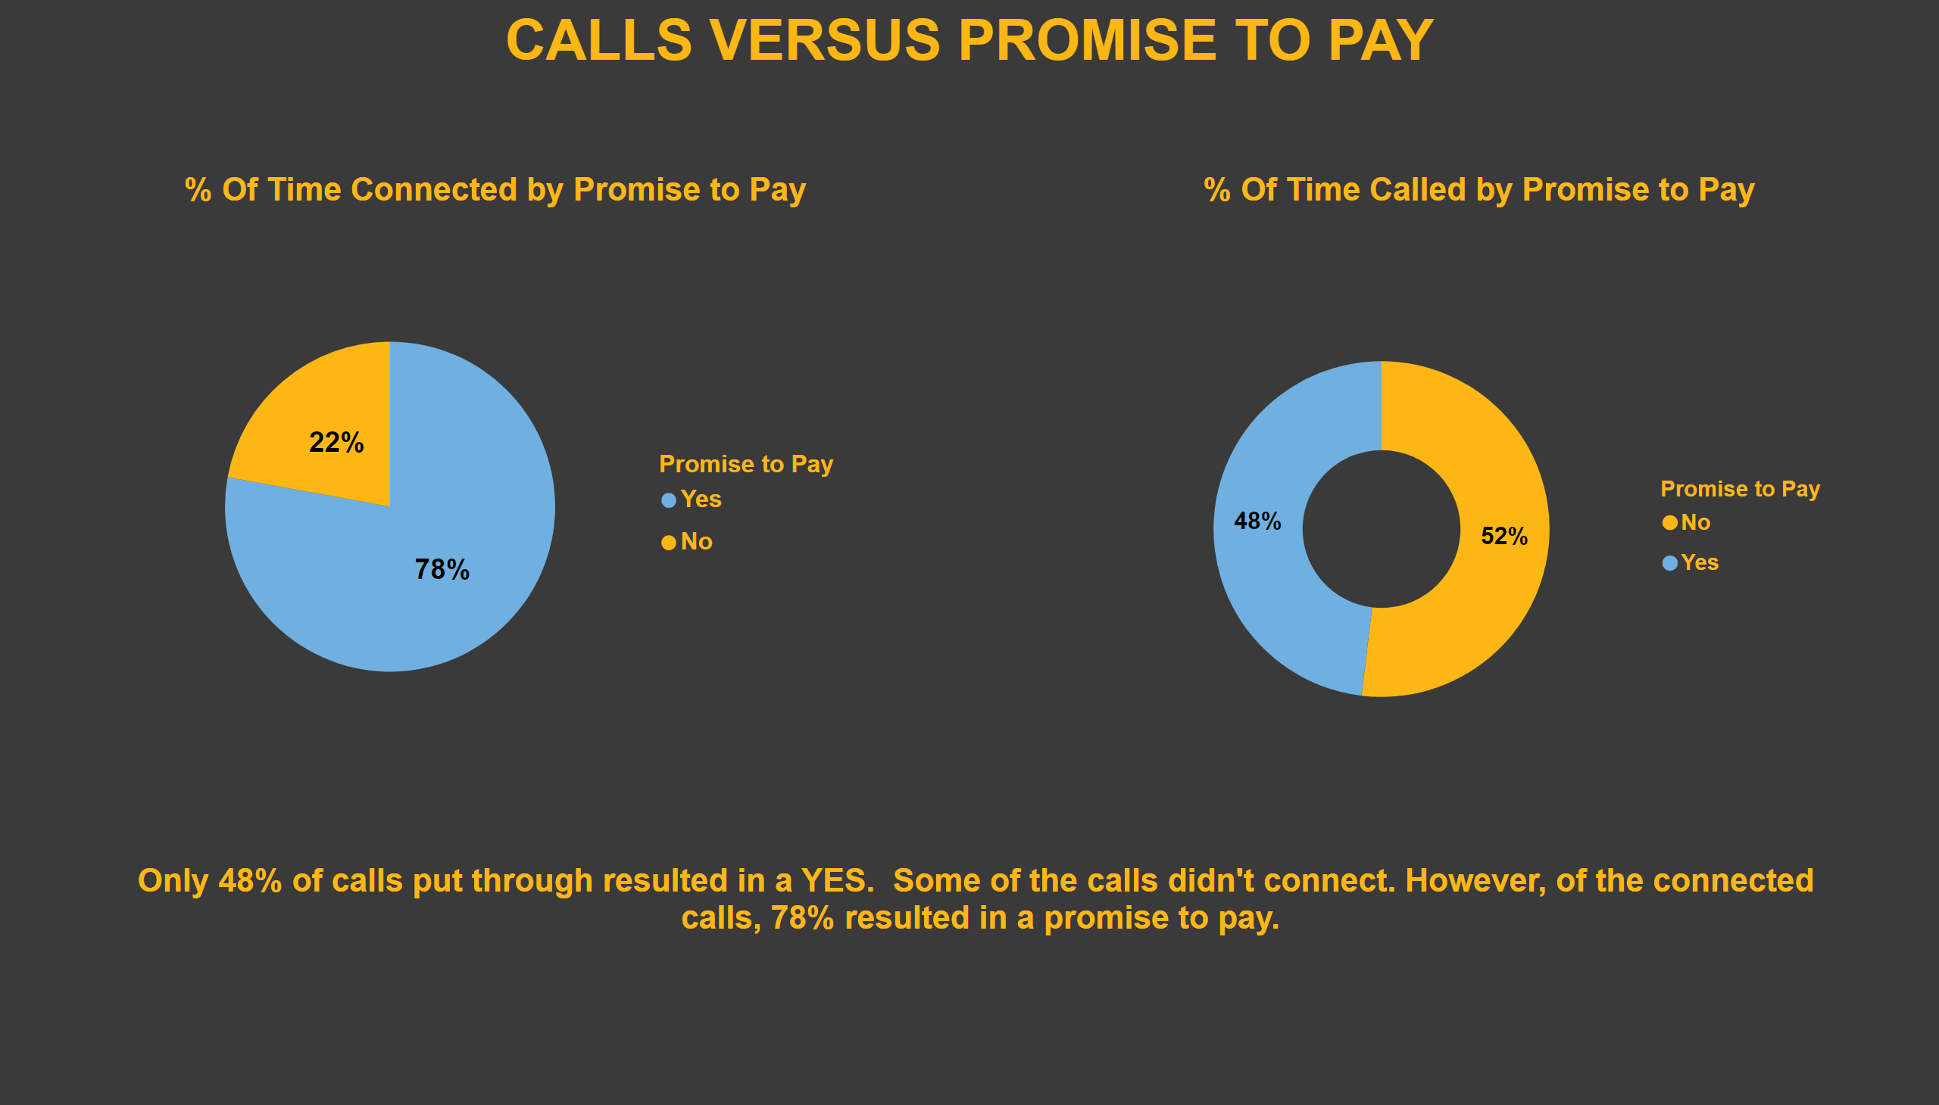
1 % Call To Promise To Pay
Notes:
% Of Time Connected by Promise to Pay
No alt text provided
% Of Time Called by Promise to Pay
No alt text provided
textbox
No alt text provided
textbox
No alt text provided

Slide 5
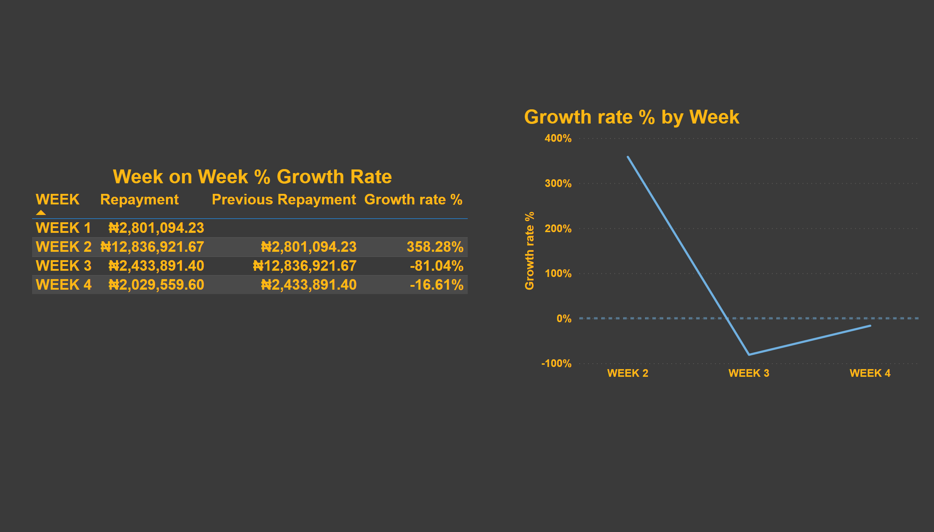
2 Week on Week Growth Rate
Notes:
Week on Week % Growth Rate
No alt text provided
Growth rate % by Week
No alt text provided

Slide 6
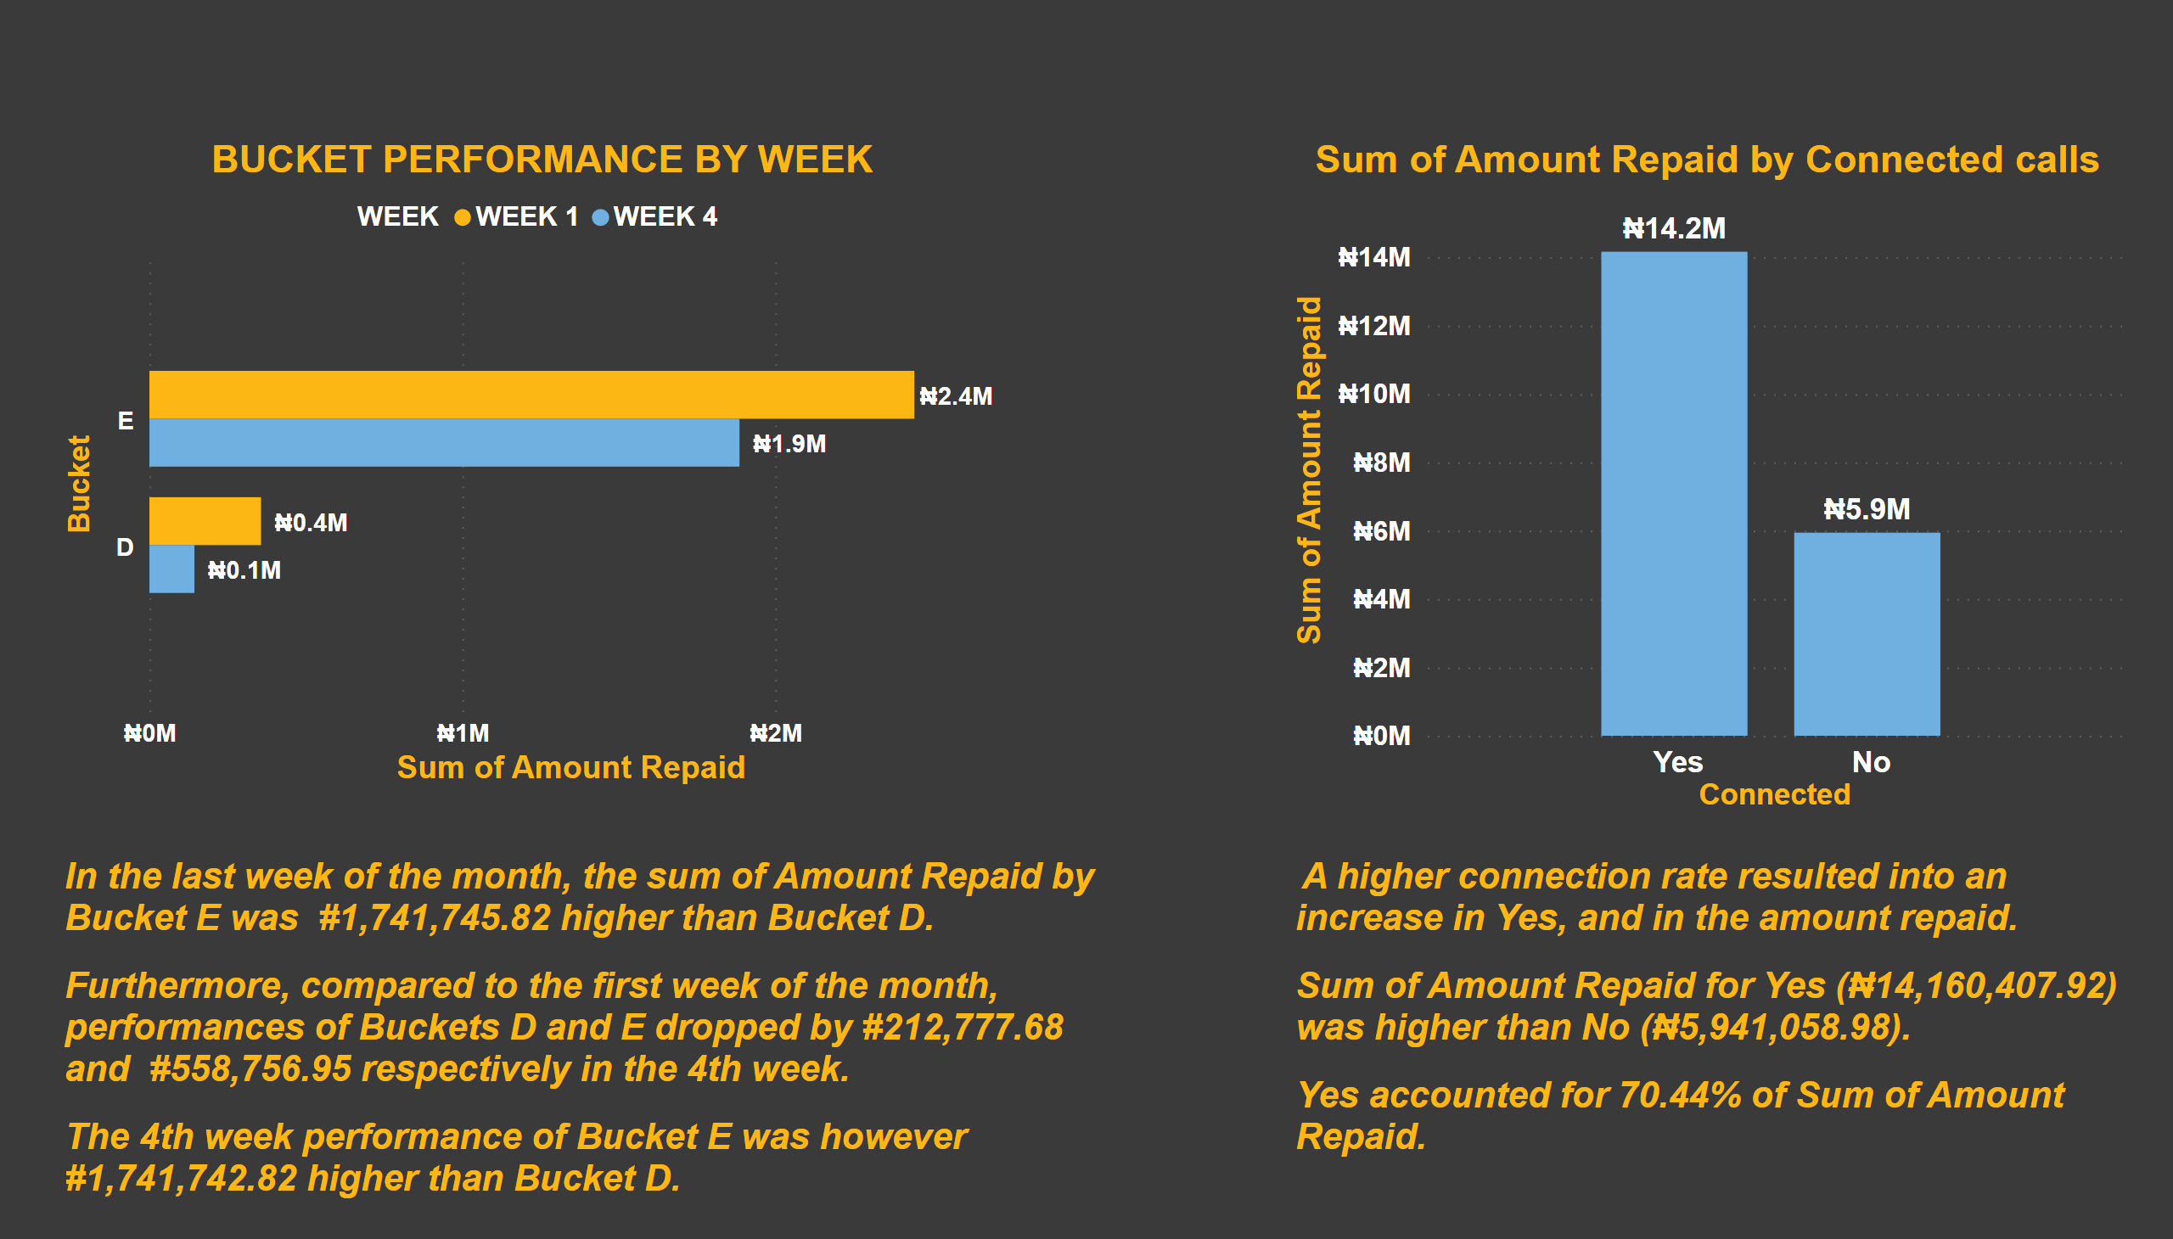
3 &4 Bucket Performance
Notes:
BUCKET PERFORMANCE BY WEEK
No alt text provided
Sum of Amount Repaid by Connected calls
No alt text provided
textbox
No alt text provided
textbox
No alt text provided

Slide 7
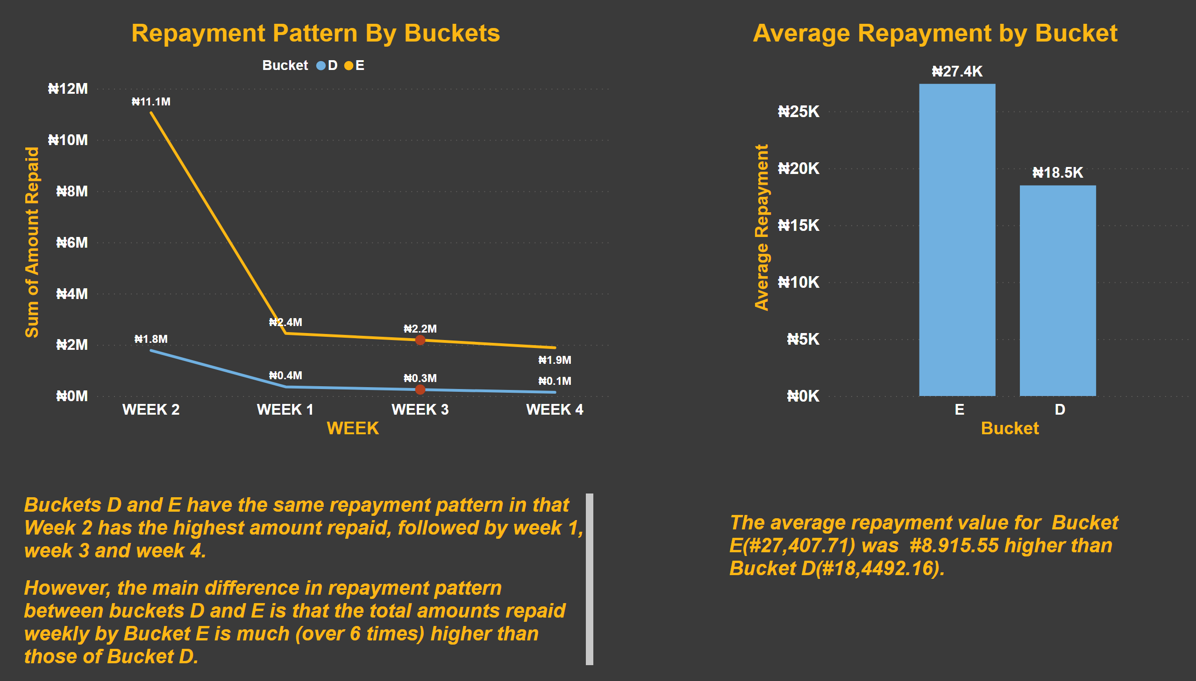
5 &6 Repayment Pattern
Notes:
clusteredColumnChart
No alt text provided
Repayment Pattern By Buckets
No alt text provided
textbox
No alt text provided
textbox
No alt text provided

Slide 8
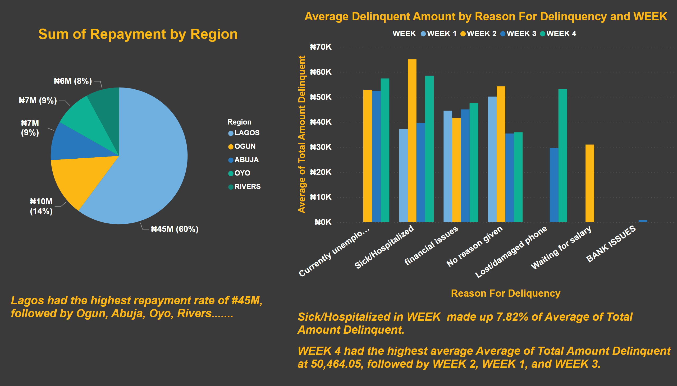
7 &8 Average Delinquent Amount
Notes:
Sum of Repayment by Region
No alt text provided
Average Delinquent Amount by Reason For Delinquency and WEEK
No alt text provided
textbox
No alt text provided
textbox
No alt text provided

Slide 9
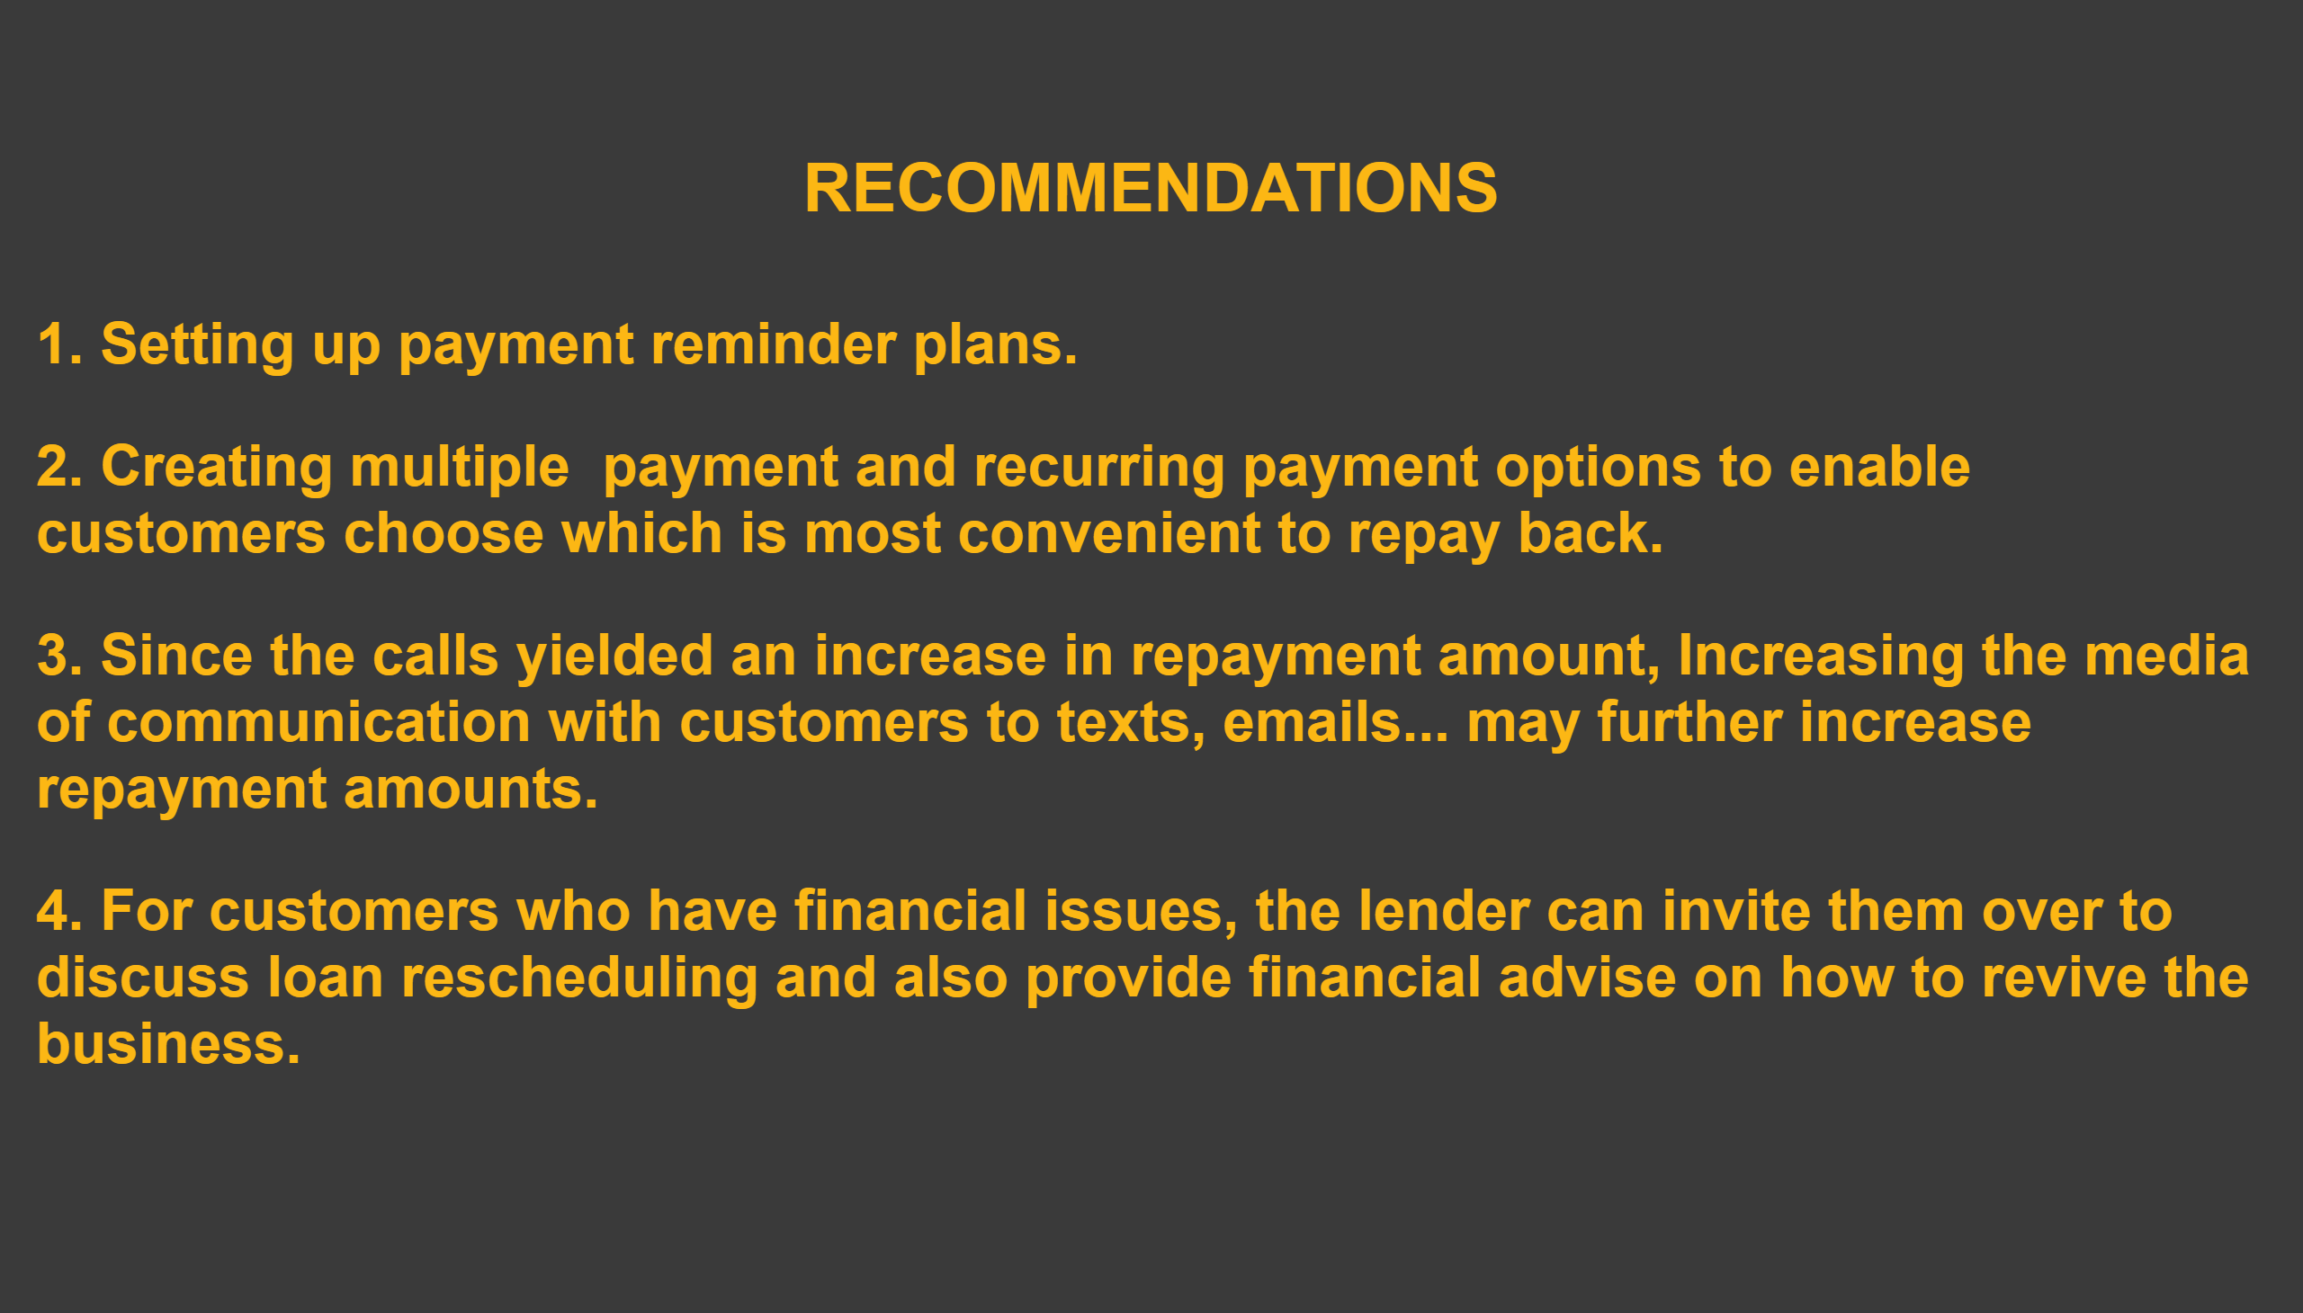
Recommendations
Notes:
textbox
No alt text provided

